Slide 1
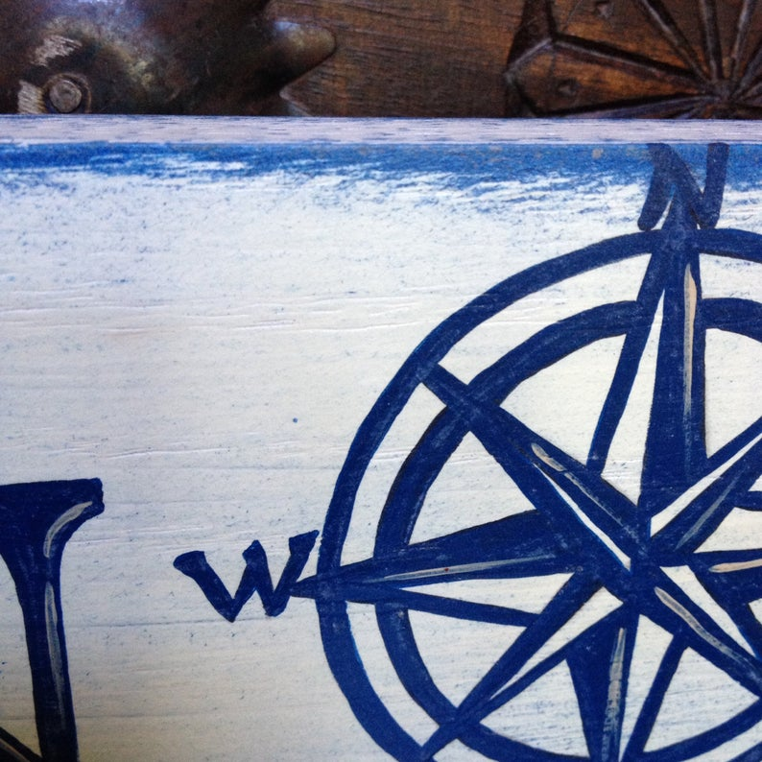
Unit 8
Longitude

Slide 2
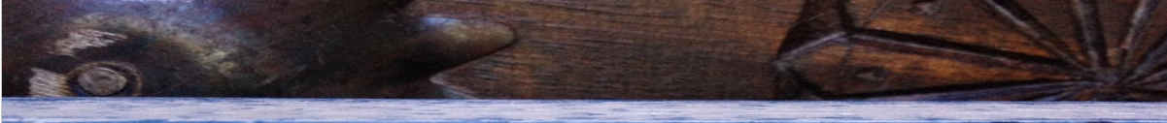
Unit 8
Warm Up
Look at the globe and match the words with their Chinese equivalents.
the Tropic of Capricorn
经度
the North Pole
南回归线
longitude
本初子午线
the Arctic Circle
黄道
the Tropic of Cancer
赤道
the prime meridian
北回归线
latitude
北极
the Equator
北极圈
the Ecliptic
纬度

Slide 3
Longitude and latitude
Unit 8
Warm Up
Look at the lines marked on the globe. What purpose do they serve?
They are the lines of longitude and latitude which are used for measuring distance and time around the world, and locating places on the globe.

Slide 4
Longitude and latitude
Unit 8
Warm Up
Work in pairs. Discuss the questions.
1. What determines where lines of longitude are placed?
2. What determines where lines of latitude are placed?
3. The invention of what machine was necessary before longitude could be accurately measured?
click
click

Slide 5
Longitude and latitude
Unit 8
Warm Up
1. What determines where lines of longitude are placed?
Lines of longitude are determined by the laws of nature.
The placement of the longitude lines is a political decision.
or

Slide 6
Longitude and latitude
Unit 8
Warm Up
2. What determines where lines of latitude are placed?
The laws of nature.
3. The invention of what machine was necessary before longitude could be accurately measured?
Accurate clocks.

Slide 7
Unit 8
Text Orgnization
Work in groups and outline the passage by filling in the missing information.
(Paras. 1-5) My childhood’s trick for ________________________________________.
(Paras. 6-8) The way how Ptolemy and later mapmakers ________________________________________.
(Paras. 9-14) The real, hard core differences or difficulties in ________________________________________.
remembering the difference between latitude and longitude
marked / placed the latitude and longitude line
deciding / measuring / calculating the longitude degrees

Slide 8
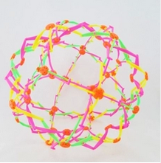
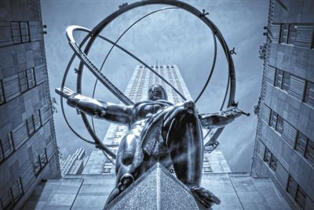
Unit 8
Text Orgnization
Marking latitude and longitude
Complete the table to see how different people mentioned in the passage mark latitude and longitude.
a beaded wire ball
The bronze orb
the statue of Atlas

Slide 9
Unit 8
Text Orgnization
Marking latitude and longitude
who | how
the writer as a child
Ptolemy
sailors in the Age of Exploration
the latitude lines stay parallel
the meridians of longitude loop from the North Pole to the South and converge at the ends of the Earth
marked the Equator for the zero-degree latitude while observing the motions of the heavenly bodies
free to lay the zero-degree longitude line
Since the measurement of longitude meridians is tempered by time, there was a lack of a practical method of determining longitude because precise knowledge of the hour was utterly unattainable in the era of pendulum clocks

Slide 10
Difficult sentences
Unit 8
click
1. ... and national boundaries repeatedly redrawn by war and peace. (Para 4)
click
2. Ptolemy himself had only an armchair appreciation of the wider world. (Para 6)
click
3. … assume their positions at the sun’s command. (Para 7)
4. … and turns the determination of longitude, especially at sea into an adult dilemma – one that stumped the wisest minds of the world for the better part of human history. (Para 9)
click
click
5. The measurement of longitude meridians, in comparison, is tempered by time. (Para 11)

Slide 11
Difficult sentences
Unit 8
1. ... and national boundaries repeatedly redrawn by war and peace. (Para 4)
Paraphrase the sentence.
click
The borders of countries are changed by war and peace treaties.
click
Make a sentence on your own by using repeatedly.
We have repeatedly called for an official investigation into the affair.

Slide 12
Difficult sentences
Unit 8
2. Ptolemy himself had only an armchair appreciation of the wider world. (Para 6)
Paraphrase the sentence.
click
Ptolemy had never travelled. His information about the wider world came from books.
click
Make a sentence on your own by using appreciation.
There is a growing appreciation of the need for environmental reforms.

Slide 13
Difficult sentences
Unit 8
3. … assume their positions at the sun’s command. (Para 7)
Are they human choices?
click
They have been fixed according to the sun’s motion as seen from the Earth. They are not fixed by human choices.
Make up a sentence on your own by using position.
click
Place the plant in a bright sunny position.

Slide 14
Difficult sentences
Unit 8
4. … and turns the determination of longitude, especially at sea into an adult dilemma – one that stumped the wisest minds of the world for the better part of human history. (Para 9)
What is the meaning of stumped the wisest minds of the world?
click
Stumped the wisest minds of the world means no one could solve it even though some clever people tried. If a problem stumps someone, they cannot think of a solution.
click
Paraphrase the sentence.
… and makes it hard to determine the longitude, especially when people are taking navigation at sea.

Slide 15
Difficult sentences
Unit 8
5. The measurement of longitude meridians, in comparison, is tempered by time. (Para 11)
What is the meaning of tempered by time?
click
Tempered by time means reliant on knowing the time.

Slide 16

Words & Expressions
Words & Phrases
Unit 8
excursion n. [C] a short journey you take for pleasure
短途旅行；远足
1. We went on an all-day excursion to the island..
我们到岛上去游览了一整天。
2. After the mid-term exam, the students decided to go on an excursion to let off steam.
期中考试以后，学生们决定外出远足以放松一下紧张的情绪。
3. After a brief excursion into drama, he concentrated on his main interest, which was poetry.
他短暂涉猎过戏剧之后便把全部精力投入到他的主要兴趣—诗歌中去了。

Slide 17

Words & Expressions
Words & Phrases
Unit 8
haphazardly ad. done in a way that does not seem to be carefully planned or organized 无计划地；杂乱无章地
e.g.
1. The books were placed haphazardly on the shelf.
书籍乱七八糟地堆放在书架上。
2. Looking for a job haphazardly, because you majored in something or because you saw a listing that looks somewhat interesting, you’ll risk getting started in a career that holds no real appeal for you, and then you’ll have to leave it to find something else.
因为你主修某个专业，或因为你看到一条信息你感兴趣，就随便找个工作，那么你就有可能会从事一项你并不喜欢的工作，然后你不得不离职，寻找新工作。

Slide 18
Words & Expressions
Language Points
Unit 8
the high seas: n. (pl) seas that are not controlled by any country （远离陆地的）公海
e.g.
1. I think it was against Geneva Convention on the high seas, 1958.
我认为这违背了1958年的日内瓦公海公约。
2. Holland once competed with England for the mastery of the high seas.
荷兰曾经同英国争夺公海的控制权。

Slide 19
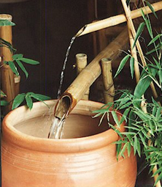
hollow
Unit 8
Words & Expressions
adj. empty inside 空的，空心的
v. to make or build something by making a hole in something 把······挖空
Translate the sentence into English.
这棵树的树干完全空了。
The tree trunk was completely hollow.
这个圆形露天竞技场是把陡坡挖空建成的。
The amphitheatre had been hollowed out of the steep hillside.

Slide 20
Words & Expressions
Unit 8
Answer these questions.
1. What does it mean when you hear a hollow sound?
The hollow sound is a low sound like something empty being hit.
2. What’s the meaning of hollow promises or threats?
The hollow promises or threats are not sincere, or are about things that will not really happen.

Slide 21
Words & Expressions
Unit 8
Discuss the meaning of the phrases.
1. a hollow display of friendship
毫无诚意的友谊表示
2. a hollow victory
有名无实的胜利
3. a hollow laugh
干笑；干巴巴的笑声
4. have a hollow ring / ring hollow
看上去不诚恳（或不真实）

Slide 22
sphere
Unit 8
Words & Expressions
n. 1) an object that is round like a ball 球体
2) particular area of interest, activity, or responsibility （兴趣、活动、工作）的范围
Words that are frequently used with sphere:
financial / political / scientific
sphere
Translate the sentences.
1) The Earth is not a perfect sphere.
地球并不是一个标准的球体。
2) 妇女们开始担负起家庭之外的责任.
Women were beginning to take responsibility for things outside the domestic sphere.

Slide 23

Words & Expressions
Words & Phrases
Unit 8
see-through a. made of cloth or plastic that you can see through; transparent 透明的
e.g.
1. This shirt’s a bit see-through when it’s wet.
这件衬衫湿了有点透明。
2. The inflatable, see-through spheres are common at amusement parks, malls and fairs in the us, Australia and Europe.
这种充气透明球体在美国、澳大利亚和欧洲的游乐园、大型购物中心和露天游乐场很常见。

Slide 24


Words & Expressions
Words & Phrases
Unit 8
grid n. [C] a pattern of straight lines that cross each other to form squares 格子；网格
e.g.
1. The streets are laid out on a grid pattern.
一条条街道呈棋盘状分布。
2. The project is designed to generate around 30
megawatts of power for the national grid.
该工程规划为国家电网发电约3千万瓦。

Slide 25

Words & Expressions
Words & Phrases
Unit 8
configuration n. [C, U] the way that the different parts of sth. are arranged to make a particular shape 外形；构造
e.g.
1. Geographers study the configuration of the mountains.
地理学家研究山脉的地形轮廓。
2. The boy was interested in the configuration of stars in the sky.
男孩对天空中星星的布排构图感兴趣。

Slide 26

Words & Expressions
Words & Phrases
Unit 8
underneath prep. in, to, or through a place directly below sth. or covered by it 在…下面；在…底下；向…下面；通过…下面
e.g.
1. I’ll leave the key underneath the mat.
我会把钥匙放在垫子下面。
2. She searched through the pile of papers and found his letter underneath.
她在一堆文件里搜寻，终于在底下找到了他的信。
3. Underneath his aloof air, Nicky was a warm and open young man.
年轻的尼克外表冷漠，实际上为人热情坦诚。

Slide 27
Unit 8
Words & Expressions
Match the functions of underneath in the sentences.
I took the gun and hid it
underneath the sofa.
as an adverb without
following a noun
Underneath he is a very
pleasant man.
as a preposition
followed by noun
The underneath part is blue and grey.
as a singular noun
after ‘the’
Looking at the car, I could
see that the underneath
was rusty.
as an adjective

Slide 28

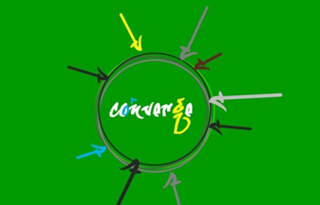
Words & Phrases
Unit 8
Words & Expressions
converge vi. to come from different directions to reach the same point 汇合；聚集
e.g.
1. As they flow south, the three rivers converge.
那三条大河向南流，渐渐汇合在一起。
2. The paths across the park converge at / toward the main gate.
一条条穿过公园的道路在 / 向着大门口汇聚。

Slide 29
Words & Phrases
Unit 8
Words & Expressions
crisscross v. to form a pattern of straight lines that cross one another （在…上）画交叉线
e.g.
1. Little cracks crisscrossed the wall.
墙上有许多纵横交叉的小裂缝。
2. Freeways crisscross the whole of Los Angeles.
整个洛杉矶地区的高速公路纵横交错。

Slide 30

Words & Phrases
Unit 8
Words & Expressions
armchair a. (only before noun) interested in a subject or activity, but lacking any practical experience of it 空谈的；没有实际经验的
e.g.
1. He is an armchair politician.
他是一个夸夸其谈的政客。
2. We don’t need an armchair football coach.
我们不需要一名纸上谈兵的足球教练。

Slide 31

Words & Phrases
Unit 8
Words & Expressions
arbitrarily ad. not based on any particular plan or done for any particular reason 任意地；随意地；随心所欲地；武断地
e.g.
1. The decision was not made arbitrarily. It was based on wide investigation.
这个决定不是随意作出的，是在广泛调查的基础上作出的。
2. It is unjust if one party should treat a contract arbitrarily at the expense of the other.
如果合同一方可以任意对待履约而使对方蒙受损害，当然不能认为公正。
3. He did everything arbitrarily.
他这人做事非常专断。
Word family: arbitrary a.

Slide 32

Words & Phrases
Unit 8
Words & Expressions
predecessor n. [C] the person who had a job or official position before sb. else 前任；前辈
e.g.
1. As a scholar he is not in the same street with his predecessors.
作为学者，他远不如其前辈。
2. The new President’s foreign policy is very similar to that of his predecessor.
新总统的外交政策和前任很相似。
Antonym: successor n. 接班人, 继任人

Slide 33
Words & Expressions
Words & Phrases
Unit 8
a way of referring to time, especially when you are talking about it passing very quickly
the sands of time
His name has been buried in the sands of time, but his plans have been preserved.
他的名字已被埋葬在时间的沙子，但他的计划也得到了保护。
Ignorant youth, in the sands of time, flowing from silk; raise time, a gradual change in the season, gradually submerged.
懵懂的年华，在时间的沙漏里，丝丝流过；觥筹的岁月，在渐变的季节里，渐渐淹没。

Slide 34
Unit 8
Words & Expressions
Match the meanings of the phrases in the sentences.
an idea or plan that is not
very sensible or practical
and is likely to fail
bury your head in the sand
referring to time, especially when you are talking about it passing
very quickly
a house built on sand
the sands of time
to pretend that a problem does not exist

Slide 35
Unit 8
Words & Expressions
child’s play
something that is easy to do 轻而易举的事
These two genetic Cousins of English, in the Indo-European language family, are child's play compared with some.
这两门语言都属于印欧语系，是英语的近亲，和其他一些语言比起来，简直是小儿科。
This will make the hurricanes looks like child's play,' he said, referring to a series of storms that swept through Haiti in 2008.
他说，跟这次地震比，2008年袭击海地的一系列飓风简直像小孩子的把戏。

Slide 36
stump
Unit 8
Words & Expressions
v. 1) if you are stumped by something, you
cannot explain or answer it 为某事困惑；被（某问题）难住
2) to walk, hitting the ground hard with your feet as you go (+ away / off) 迈着沉重的步子走；跺着脚
Translate the sentence into English.
1) 即使是专家也无法解释这种奇怪的天气。
Even experts are stumped by this strange weather.
2) 他转过身,生气地跺着脚走开了。
He turned and stumped away angrily.

Slide 37
Words & Phrases
Unit 8
Words & Expressions
the better part of sth.: almost all of sth., especially a period of time （尤指一段时间的）绝大部分
e.g.
1. Negotiations between them took the better part of the month.
双方花了大半个月进行协商。
2. We have been waiting for the better part of an hour.
我们已等了大半个钟头。
3. Father drank the better part of a bottle of whisky last night.
昨晚父亲喝了大半瓶威士忌。

Slide 38
the better part of sth.
Unit 8
Words & Expressions
Fill in the blanks with the phrases in the column.
be part and parcel of sth. the better part of sth.
for the most part for sb.’s part
have a part to play (in sth.) part of me / him etc
want no part of sth. in part
wanted no part of it
(1) It was a bad idea and he _______________________.
(2) __________________ still wants to believe you.
(3) We all ________________________ in fighting the battle against crime.
Part of me
have a part to play

Slide 39
Unit 8
Words & Expressions
be part and parcel of sth. the better part of sth.
for the most part for sb.’s part
have a part to play (in sth.) part of me / him etc
want no part of sth. in part
in part
(4) The accidents were due _______ to the bad weather.
(5) __________________ I would prefer to continue with the current plan.
(6) There were a few complaints, but __________________ people seemed to enjoy themselves.
For my part
for the most part
the better part of
(7) The journey will take him ___________________________ a year.
(8) These little arguments were ______________________ their relationship.
part and parcel of

Slide 40
Words & Phrases
Unit 8
Words & Expressions
worth one’s salt: respected by other people because you do your job well; deserving what one earns; fulfilling one’s function, or performing one’s work completely; worthy of respect 称职的；胜任的；值得尊敬的
e.g.
1. He is so useless as to be hardly worth his salt.
他可真无用，几乎配不上他所领的薪水。
2. You’ve got to prove that you’re worth your salt, or you’re not going to have the job long.
你必须证明你的才能，否则你不可能干很长的时间。
3. Any player worth their salt would love to play for their country.
任何一个称职的运动员都会乐意为国家效力。

Slide 41
Unit 8
Words & Expressions
Match the meanings of the phrases.
rub salt in a wound
to do or say something that makes someone who already feels bad feel worse
the salt of the earth
to doubt the truth or value of something
take sth. with a pinch
of salt
an ordinary person who is
respected because they
are honest and good
worth one’s salt
respected by other people
because you do your job well

Slide 42

Words & Phrases
Unit 8
Words & Expressions
intervene vi. to delay an event or make it difficult to do 干扰；阻挠；打扰
e.g.
1. When riot broke out, the police were obliged to intervene.
发生暴乱时, 警察有责任阻挠。
2. Who do you think you are to intervene in the internal affairs of other countries?
你干涉别国内政，你以为你是谁啊？

Slide 43
temper
Unit 8
Words & Expressions
v. (fml) to make something less strong or extreme, especially by adding something that has the opposite effect 使···缓和；使温和，冲淡
Translate the sentence into English.
是该用现实冲淡理想的时候了。
The time had come to temper idealism with reality.
To meet the target, it would have to let the renminbi rise to increase its imports and temper export growth.
为了达到限制贸易不平衡规模的目标，中国必须让人民币升值，以便增加进口，减缓出口增长。

Slide 44
temper
Unit 8
Words & Expressions
n. 1) a tendency to get angry very quickly 坏脾 气；容易发怒的性情
List words which are frequently used with temper.
bad
fiery
foul
nasty
quick
short
violent
temper

Slide 45
temper
Unit 8
Words & Expressions
n. 2) a particular emotional state or mood 心情；情绪
Discuss the meaning of the phrases.
1. in a bad / foul / terrible (good) temper
心情坏（好）
2. get / fly into a temper
大发脾气
3. be in a temper
大怒
4. a fit of temper
一阵狂怒

Slide 46

Words & Phrases
Unit 8
Words & Expressions
discrepancy n. [C, U] a difference between things that should be the same 差异；差额；不一致
e.g.
1. What are the reasons for the discrepancy between girls' and boys' performance in school?
女生和男生在学校表现不同的原因何在呢？
2. There was a discrepancy in the two reports of the accident.
关于那次事故的两则报道有不一致之处。

Slide 47
Unit 8
Words & Expressions
translate
to change sth, or to be changed, into a different form （使）转变，变为
Most of all, the surge in the market was so rapid that it did not translate into a strong effect on spending.
最重要的是，股市上涨速度太快，还未来得及对消费产生强劲效应。
But Lagarde added that the pick-up in financial conditions in the US, Europe and Japan has yet to translate into a sustainable recovery.
但拉加德说，美国、欧洲和日本财政状况的好转尚未转化为可持续的复苏。

Slide 48
subtle
Unit 8
Words & Expressions
Match the meanings of subtle in the sentences.
1) He was so subtle that I
didn’t realize he liked me.
a) not obvious and
therefore difficult to notice
2) I detected a subtle change
in his attitude towards us.
b) delicate and complicated in an attractive way
c) indirect in a way
that prevents people from noticing what you are trying to do
3) I like these intricate and
subtle patterns.

Slide 49

Words & Phrases
Unit 8
Words & Expressions
willy-nilly ad. if sth. happens willy-nilly, it happens whether you want it to or not 不管愿不愿意；无可奈何地
e.g.
1. He would be forced to collaborate willy-nilly.
无论是否愿意，他都得合作。
2. She was forced willy-nilly to accept the company’s proposals.
她无可奈何地接受了公司的提议。
3. Today’s church is being forced willy-nilly to deal with today’s social problems.
不管愿不愿意， 如今的教堂都要被迫应对当今的社会问题。

Slide 50
Unit 8
Useful Expressions
1.空心球
1. a hollow sphere
2.公海
2. the high seas
3.赤道
3. the Equator
4.黄道
4. the Ecliptic
5.北回归线
5. the Tropic of Cancer
6.南回归线
6. the Tropic of Capricorn
7.北极圈
7. the Arctic Circle
8.子午线
8. the prime meridian
9.同心圆
9. concentric rings

Slide 51
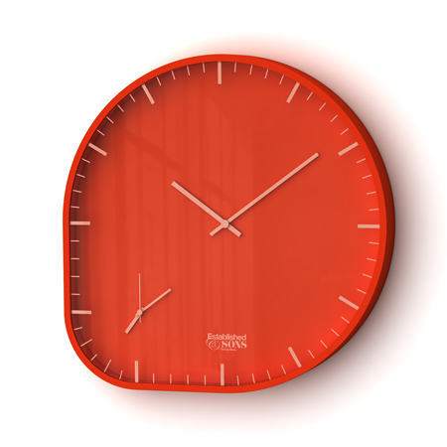
Unit 8
Useful Expressions
10.北/南极
10. the North / South Pole
11.按字母顺序
11. in alphabetical order
12.天体运动
12. the motions of the heavenly bodies
13.称职的水手
13. the sailor worth his salt

